Slide 1
Battle of neighborhoods
Optimal neighborhood recommender for food bank

Slide 2
Problem description
Food wastage is a serious issue in United States, approximately 125 to 150 billion pounds of food or $220 billion is being wasted every year. Meanwhile, 12% of american households are food insecure according to https://foodprint.org/issues/the-problem-of-food-waste/. A major step to reduce food insecurity would be to divert or minimize this food wastage.
Our aim here is to build a food bank that collects edible food from the above food hubs and keeps it distribution ready for people who visit the food bank.
We have chosen Boston city as high level location of the food bank, as Boston has lot of food chains and has a higher amount of food waste, so we could act upon this and divert the food to the needy.

Slide 3
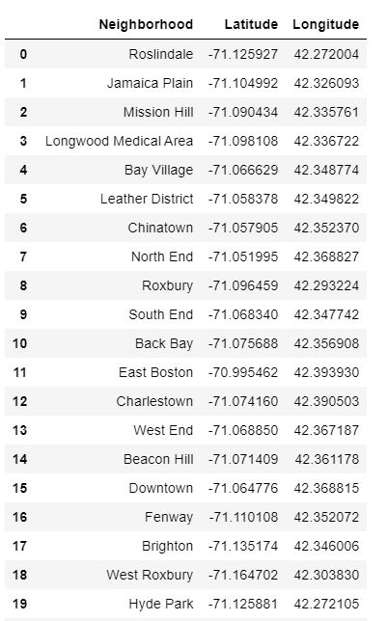
Data collection
We extracted neighborhoods data from Boston Data web page. Using BeautifulSoup4 package we scraped the web page to build a data frame that consists of Neighborhood name, latitude, and longitude. Neighborhood names are in the form of ‘Chinatown’ and ‘Downtown’, we have a total of 25 neighborhoods.
After further processing the json data we obtain a data frame that contains neighborhoods and their respective latitude and longitude values like in the snapshot.

Slide 4
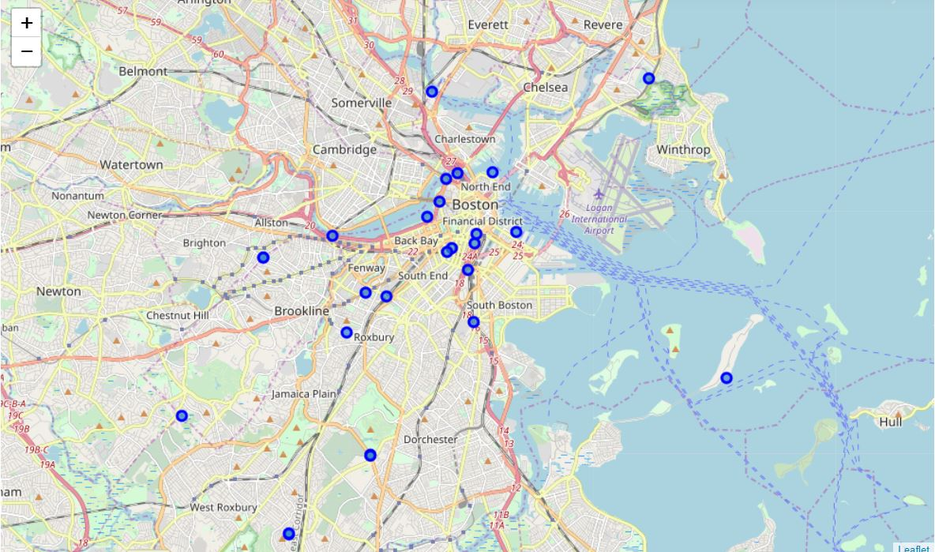
Boston city neighborhoods
Using folium package, we plotted Boston city map using the above data frame, all the neighborhood locations are plotted on the map using respective coordinates, this can be seen in the map
In this map we have plotted all the 25 neighborhoods in Boston city

Slide 5
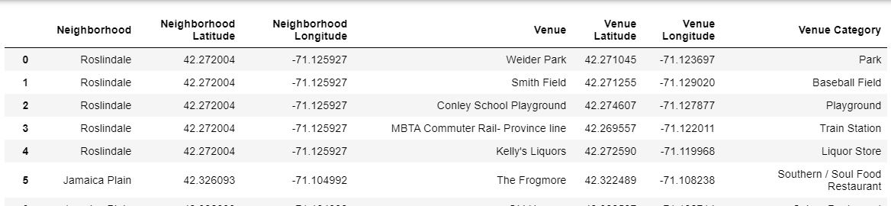
Data processing
Using foursquare API, I obtain the 100 most visited venues within 500 meters of each major neighborhoods in the above obtained data frame. Venues range from restaurants, coffee shops, gym, clothing stores, and movie theatre, below we can see how data from foursquare API looks like
In the below data frame, we can see that we have neighborhood, latitude and longitude associated to that neighborhood, one of the 100 most visited venues, latitude and longitude associated with that venue, and the venue category.

Slide 6
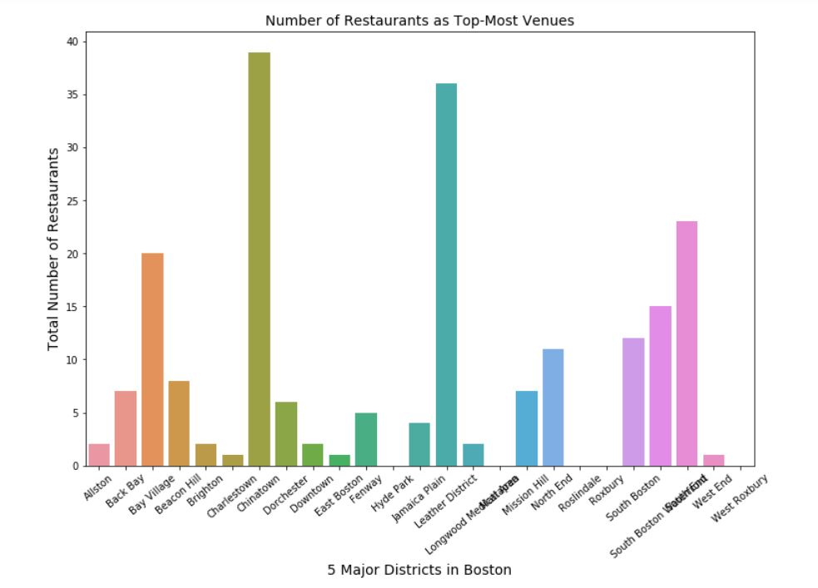
Methodology: exploratory data analysis
For each neighborhood we have obtained top 10 most frequently visited venues and categories of each of the venues. For our problem, we are interested in venue categories that are associated with food. So, we calculate number of venues that have ‘restaurant’ keyword in their venue category and sum up total venues of this type for each neighborhood.

Slide 7
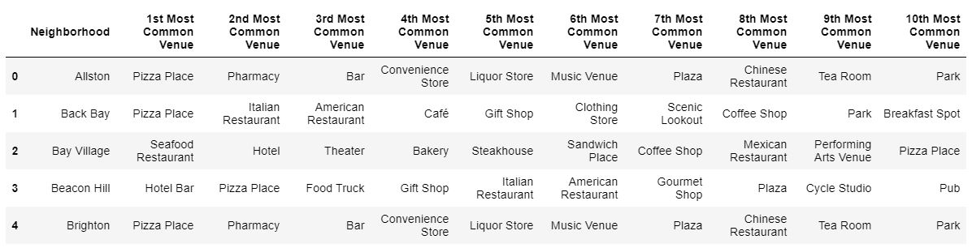
Data transformation
We build a data frame that consists of top 10 venues for each neighborhood, we perform one hot encoding on venue categories to create a data frame, then use pandas group by on neighborhood column, while grouping by we calculate mean value, after this we transpose the data frame and arrange the data frame in descending order, after performing the above operations we get the following data.

Slide 8
clustering
We have top 100 venues for each neighborhood, using this data we perform one hot encoding to obtain a data frame that contains numeric value for each venue that has been obtained after taking mean of this venue category across the neighborhood. K means algorithm is an iterative algorithm that tries to partition the dataset into K pre-defined distinct non-overlapping subgroups (clusters). After Iterating through different possible number of clusters, we have chosen number of clusters to be 7.
Here, we are trying to link each neighborhood to a cluster label, and identify which clusters have a greater number of food related venues in the top 10 venues for that neighborhood. If a neighborhood has a greater number of food related venues that means it is a food hub and possible food wastage is higher, and if this can be channeled properly to the food bank then we can reduce the wastage.

Slide 9
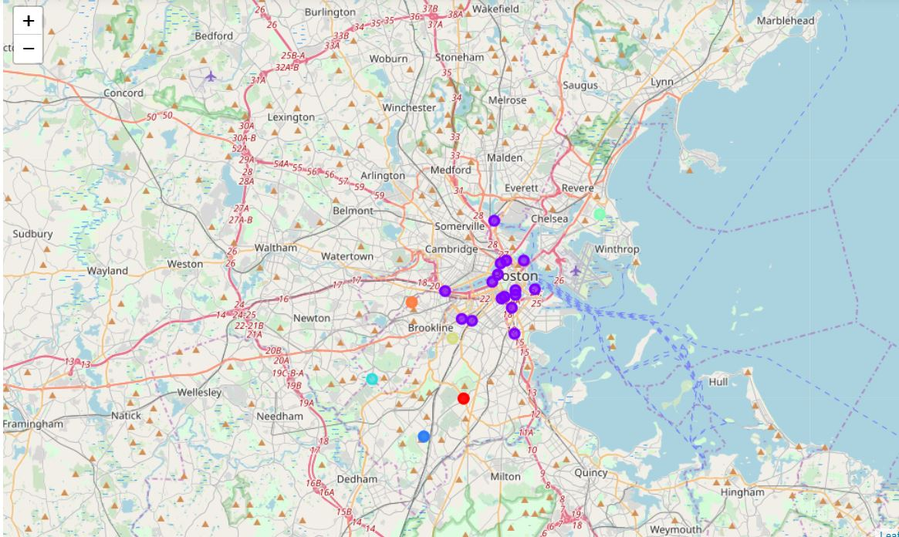
results
After clustering we get mappings for neighborhoods and cluster labels, each cluster has its own trait. In the below graph we can see how different clusters are distributed across the map.
Analyzing each of the clusters we can understand that cluster number 1 has majority of food related venues for its neighborhoods.

Slide 10
results
After careful analysis of neighborhoods in cluster 1, we can see that ‘Chinatown’, ‘Leather District’, ‘Bay Village’, ‘South End’, and ‘South Boston’ are located in close vicinity and all of these neighborhoods have majority of food places in their top 10 venues. Hence, opening a food bank in a region close to these neighborhoods would immensely reduce the amount of food wastage
We can see in graph in next slide which places form the location in which food bank can be started. The boundary that has been built using these 5 neighborhoods serves as a good location for starting the food bank. Please find this region in the below graph;

Slide 11
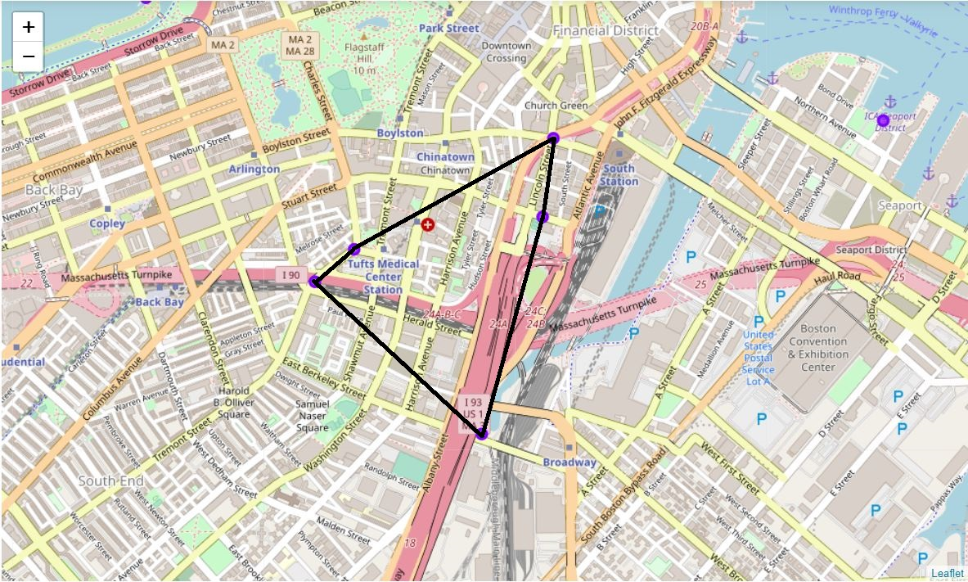
results
The region marked in the above map with ‘Chinatown’, ‘Leather District’, ‘Bay Village’, ‘South End’, and ‘South Boston’ as its vertices represents the region in which starting the food bank would be the best idea. Commuting to this location is also easy as it is located at heart of the city.

Slide 12
discussion
According to the analysis, location marked between ‘Chinatown’, ‘Leather District’, ‘Bay Village’, ‘South End’, and ‘South Boston’ is the best choice for starting a food bank. As all these neighborhoods have a greater number of food related places, hence these areas could possibly have more food wastage compared to other areas.
There are also drawbacks for this analysis- land prices in these locations have not been considered in this analysis, as food bank is a nonprofit organization we can also apply for subsidy from the government. This analysis only considers most common venues obtained using foursquare API it does not consider potential number of customers at each venue, as the number of customers will directly impacts the amount of food being prepared, this is an important variable that can be taken into consideration. We could also perform clustering using other techniques such as K Medoids, DBSCAN etc.

Slide 13
Conclusion
To conclude this project, we have got an idea about how real life data science projects are, I have used several python libraries to perform web scraping and also used Foursquare API to obtain necessary data, and then performed necessary data transformations, we have also used folium library to generate maps using geographical coordinates, in-depth analysis has been done on the data using K Means clustering technique. We have also discussed potentially best location to start a food bank and drawbacks in the analysis. After staying for more than 3 years in Boston and looking at the potentially possible locations for a food bank I am not surprised as all these locations are big food hubs in Boston city and sources of large quantities of food wastage which can be properly utilized through a food bank.

